Slide 1
WIDA CAN DO
EL Team Presentation
2019 - 2020
Notes:
JW
Background: As we looked at ESSA, the WIDA Standards, and CAN DO descriptors, and tried to mesh all of it into a 30 minute training, we knew it would overwhelm teachers. Today, our goal is empower you with some basic information, that you can use immediately, and that will lend itself to the coaching cycle. To teach the WIDA Can DO's, we will be using the I Do, We Do, You Do model of instruction.

Slide 2
EL Experiences
Notes:
Steph
Video :07 to 1:22

Slide 3
Objectives
Educators will know the background of ESSA and its’ implications for schools.
Educators will understand the basics of WIDA and their underlying CAN DO Philosophy in building awareness for ELs..
Educators will utilize the WIDA CAN DO Descriptors to support building language acquisition goals for their students.
Notes:
Steph

Slide 4
Replaced No Child Left Behind
Passed in 2015
Took effect in FY2017-2018 - Approved Summer 2018
Title III Section - Federal law requirements for school accountability of EL populations.
Notes:
Steph
ESSA determines the school grading system and in the summer of 2018 the action took effect mandating school accountability for EL students. The progress of the EL students is determined by their scores on the WIDA assessment each year. It is a high stakes test, just like RISE.

Slide 5
What is Title III?
Title III: English Language Acquisition, Language Enhancement, and Academic Achievement
Supplemental services to English Learners to help ensure that these students attain English language proficiency and succeed in the academic content areas.
Notes:
Steph
TCSD model is currently set up to provide this supplemental service mainly through good classroom instruction. EL Instructional Coaches are in place to help teachers, using the coaching cycle, to determine strategies in their teaching that can be implemented to increase understanding and learning for EL students, and really for all students. The coaches will also help Paras, teachers, and any other staff that might be working with these students, to analyze data and use this information to guide their instruction and make a plan for their learning.

Slide 6
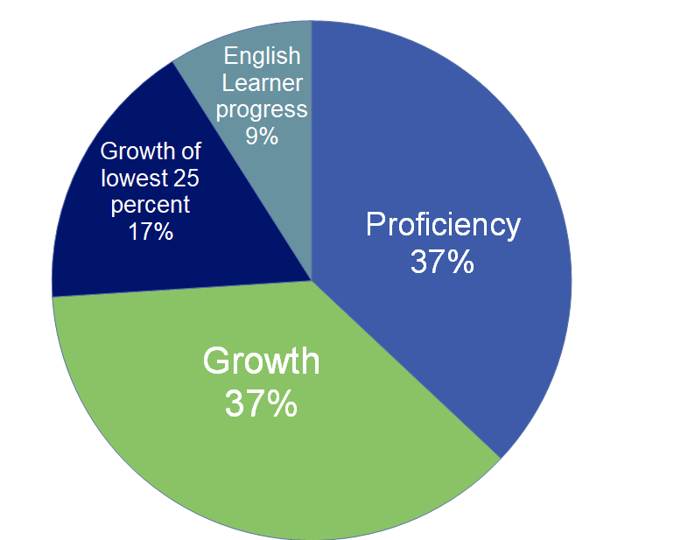
Elementary and middle school (grading)
Notes:
Steph

Slide 7
Defining WIDA
Notes:
Steph
WIDA is a consortium of 40 states.
Began in 2003 - federally funded - to create language proficiency assessment and resources for educators of multilingual learners
Utah adopted the WIDA language standards in 2010/2011 and the following year adopted all of WIDA offerings with assessments and language standards.
WIDA provides language development resources to those who support the academic success of multilingual learners.
Provides research, resources, professional development, entry and ongoing language proficiency assessments, and language standards for 4 domains (listening, speaking, reading, writing) PreK - 12th grades

Slide 8
After watching the video clip, what would your own feelings be in Moises’ situation?
Moises
Notes:
JW?

Slide 9
WIDA's CAN DO Philosophy
Value our English Learners’ Assets.
Culturally diverse learners enrich the experiences of all students.
Focus on what language learners CAN DO
By getting to know our EL students' cultural backgrounds and experiences, the more effective instruction will be.
Notes:
Jennifer
WIDA has a "Can Do" philosophy. Their Can Do Descriptors highlight what language learners can do at various stages of language development.
-- It is the belief that everyone brings valuable resources to the education community and we need to value our EL students' assest.
--It is the belief that culturally diverse learners bring a unique set of assets that can enrich the experiences of all students. Educators can draw on EL students' assets for the benefit of both the school & community.
--Teachers need to focus on what language learners can do, rather than on what they can't do. This sends a powerful message that students from diverse backgrounds contribute to the vibrancy of Pre-K to 12th grades.
--The more we know about EL cultural backgrounds and experiences, the more effective standards-based instruction will be. Educators have the power to recognize and unleash the potential that language learners bring to their learning communities.

Slide 10
WIDA Proficiency Levels
Active EL Students
Level 1 Entering
Level 2 Beginning
Level 3 Developing
Level 4 Expanding
Monitoring Status EL Students (4 years)
Level 5 Bridging
Level 6 Reaching
Notes:
Jennifer

Slide 11
WIDA Levels - 4 Domains
L
Listening
Speaking
Reading
Writing
Notes:
Jennifer
Get a WIDA score within each of the domains and then all domains combined to get the Overall Proficiency Score

Slide 12
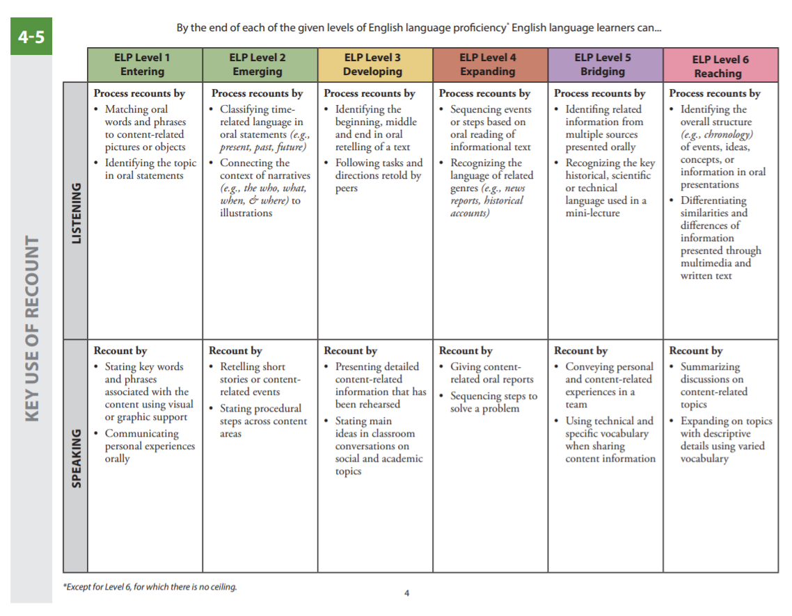
WIDA CAN DO Example
Levels
"KEY USES"
Domain
Domain
Notes:
Steph
Booklets Show

Slide 13
Listening
Speaking
Reading
Writing
Language Proficiency
Complexity of academic skills
Notes:
Steph

Slide 14
Example #1
Linh was born in the United States. Her parents are Vietnamese and arrived in the country shortly before her birth. The only language spoken in the home is Vietnamese. Linh is currently in 2nd grade and has been in school since Headstart when she was 3 years old. She is getting As and Bs on her classroom assignments, and the teacher reports that she is a stellar student. Her latest WIDA scores are:
Overall Proficiency: 3.5
Listening: 6
Speaking: 4
Reading: 3
Writing: 2
In what areas can the teacher support Linh with language development? Based on the WIDA CAN DO chart, how can the teacher support Linh’s language development progress?
Notes:
I do (Presenters) – JW Reads example – Steph Teacher Talk-Aloud
Have the teachers follow along in their CAN DO Descriptors to look for ideas to implement. We will guide this and present what we would do. We would be most concerned with reading and writing. Go to the can do descriptors for 2nd grade. Reading goals-Continue her progression with selecting titles to match a series of pictures (labeling pictures), keep providing illustrations to support vocab. New goals would be to focus on word work, cut up sentences from the text and have her order them. 2nd goal or activity, doing a word sort with science (cross curricular) to build content vocab. Student would sort specific words into general categories *example, Sort rock words, Igneous, metamorphic, sedimentary. Sort words such as shale, sandstone, granite, etc. Use cards with words and pictures. Writing goal, (prewriting would come from the word sort we just did), create a graphic organizer from word sort. In a group they could create a journal describing the differences between Igneous, Metamorphic, Sedimentary.This activity could be over multiple phases, and repeated.

Slide 15
"Distinguish between general and specific language in context"
Practice with general and specific Science vocabulary words
Flower vs Rose, Carnation, etc.
Animal vs Cheetah, elephant, etc.
Demonstrate categories using a graphic organizer
"Put words in order to form sentences"
Cut-up Sentence Strips
"Sort illustrated content words into categories"
Content vocabulary with pictures
"Sort, read and say"
Notes:
Steph

Slide 16
"Engage in prewriting strategies"
Graphic Organizer(s)
4-Square Writing
Interactive Writing to identify key words and write on whiteboard
"Complete modeled sentence starters"
Daily scaffolded sentence stems (from simple to more complex)
I like ___________________.
I am feeling __________ because ________________.
"Participate in interactive journal writing"
Learn from others
Cross-curricular
Between teacher and student
Between group and teacher
Notes:
Steph

Slide 17
Example #2
Geovanni recently arrived from Honduras. He came with his mother and his baby brother to live with his aunt and her family. He has been attending the American school for two months; he is still very shy and won’t speak to anyone. His 6th grade teacher isn’t sure what expectations she should have for him with the academic workload in the class. His screener indicates that he is a Level 1 Proficiency on all areas: Listening, Speaking, Reading, and Writing. According to the WIDA CAN DO chart, what goals can she have for Geovanni as he continues his language development progress through his 1st year in the country?
Notes:
We do (Presenters) - Steph
Talk this out as a group, come up with some strategies and ideas together.

Slide 18
Example #3
Sarai has lived in the United States for 3 years. Her family speaks both Spanish and English. In school, she has excelled socially. She loves to chat with everyone whenever given the opportunity. She is less excited to complete her 4th grade classwork though. Her WIDA scores are:
Overall proficiency: 2.5
Listening: 4
Speaking: 6
Reading: 1.5
Writing: 2
According to the WIDA CAN DO Chart, what skills can the teacher focus on to help Sarai develop her language capabilities?
Notes:
You do - Matt

Slide 19
WIDA CAN DO Descriptors
https://wida.wisc.edu/teach/can-do/descriptors
Notes:
Jennifer
Culminating activities:
*Reflection as a group on benefits of using WIDA CAN DO for their ELs.
*Individual - Choose an EL student to analyze their WIDA scores and use the CAN DO Descriptor chart to create one to two language development goals and or objectives for the next classroom lesson.

